Slide 1
REaCh – Phonology Task

Slide 2

Phonology Task

Slide 3
POA & VOT score
POA
 | Lips | Roof of Mouth | Back of Throat
Early | BA | DA | GA
Late | PA | TA | KA
VOT

Slide 4
POA score
POA
 | Lips | Roof of Mouth | Back of Throat
Early | BA | DA | GA
Late | PA | TA | KA
VOT
POA 2
POA 1
POA 1
POA 3
POA 0
POA 1
POA 0
POA 1
POA 0

Slide 5
VOT score
POA
 | Lips | Roof of Mouth | Back of Throat
Early | BA | DA | GA
Late | PA | TA | KA
VOT 0
VOT
VOT 0
VOT 1
VOT 1
VOT 1

Slide 6
Distance (D)
= VOT score + POA score
POA
 | Lips | Roof of Mouth | Back of Throat
Early | BA | DA | GA
Late | PA | TA | KA
POA 2
VOT
VOT 1

Slide 7
The new stimuli structure
Difficulty level
D3 – POA2,VOT1 (PA-GA, KA-BA)
D2 – POA1,VOT1 (BA-TA, GA-TA, PA-DA, KA-DA)
D1 – POA1,VOT0 (PA-TA, KA-TA, BA-DA, GA-DA)
D2 – POA2,VOT0 (PA-KA, BA-GA) D1 – POA0,VOT1 (TA-DA)
D1 – POA0,VOT1 (PA-BA, KA-GA)

Slide 8
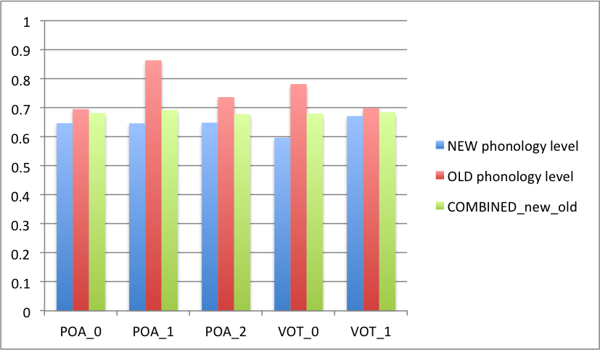
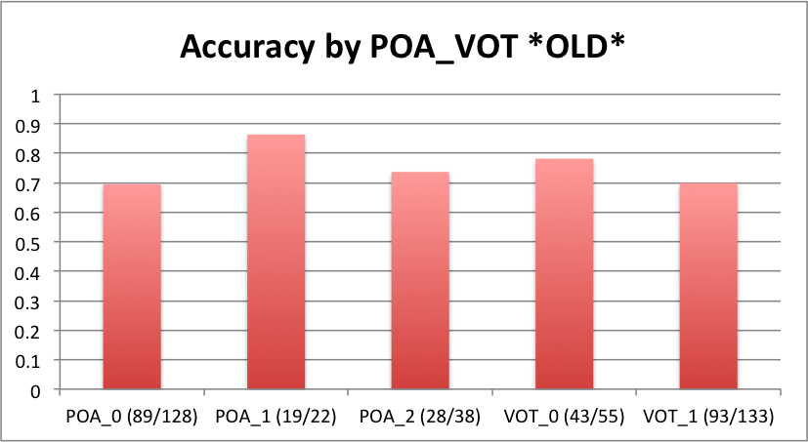
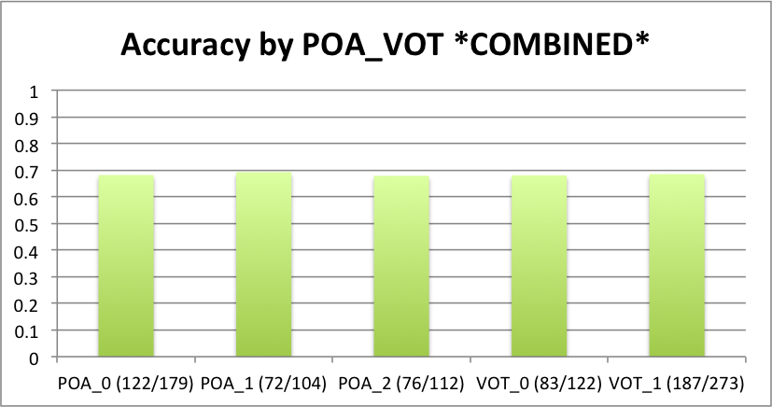
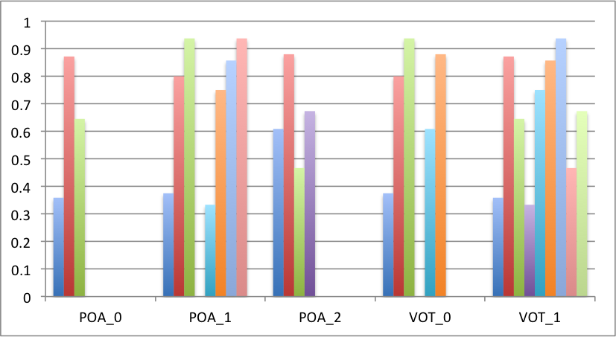
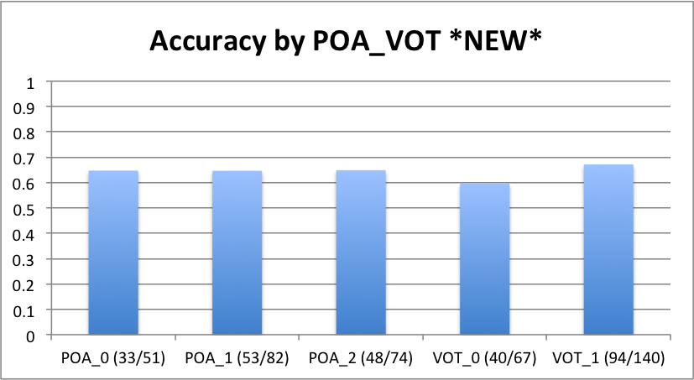
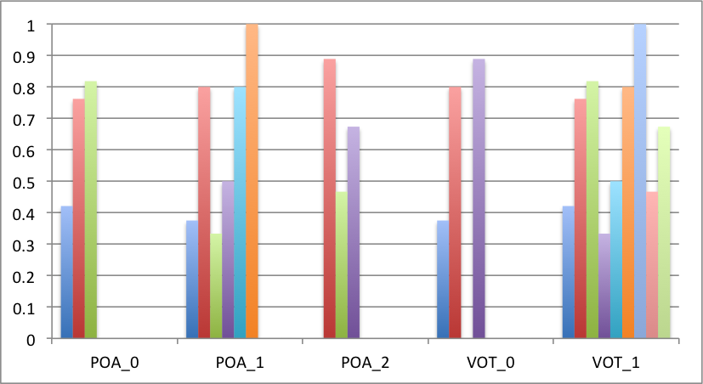
Accuracy by POA_VOT (separately)

Slide 9
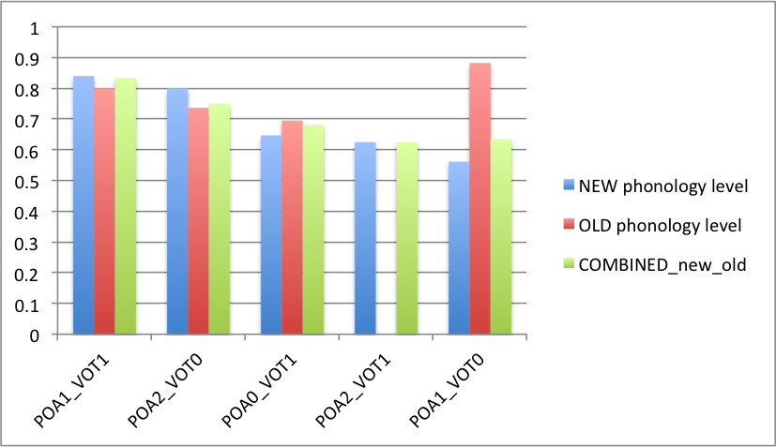
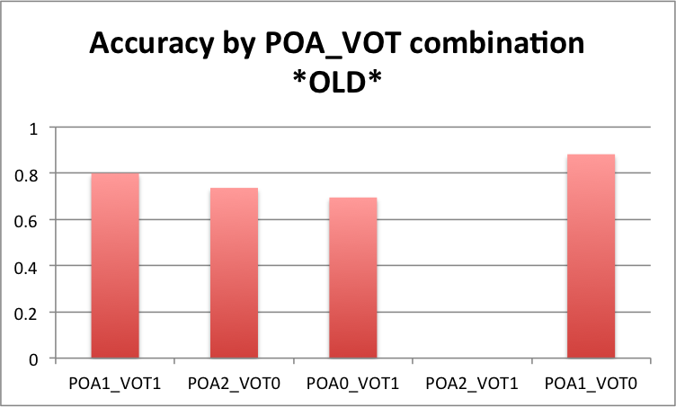
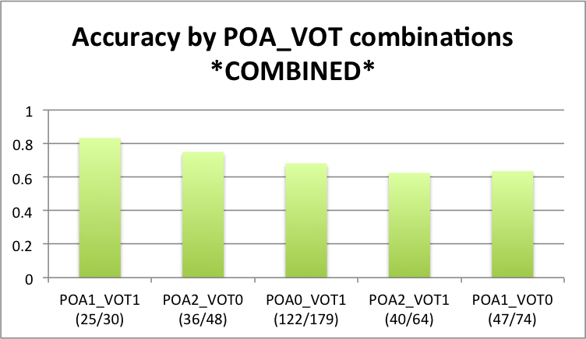
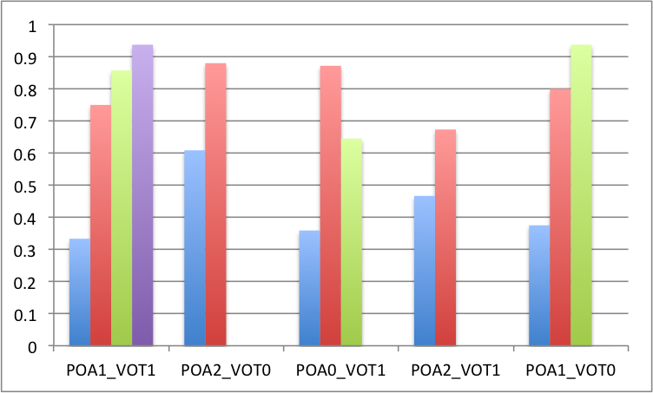
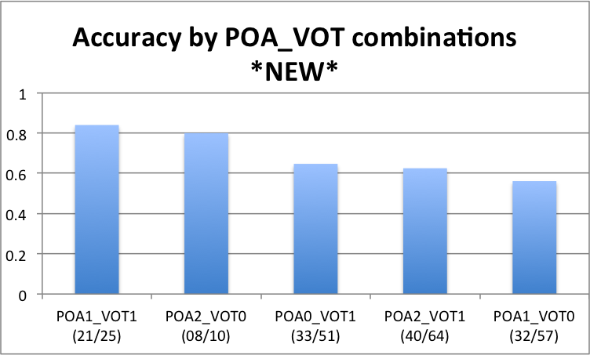
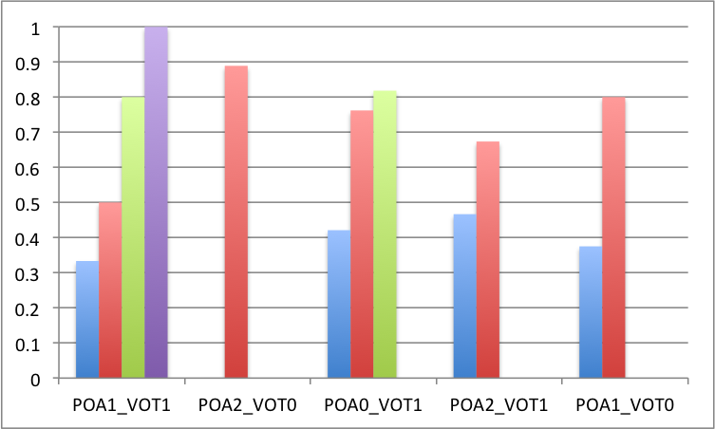
Accuracy by POA_VOT combinations

Slide 10
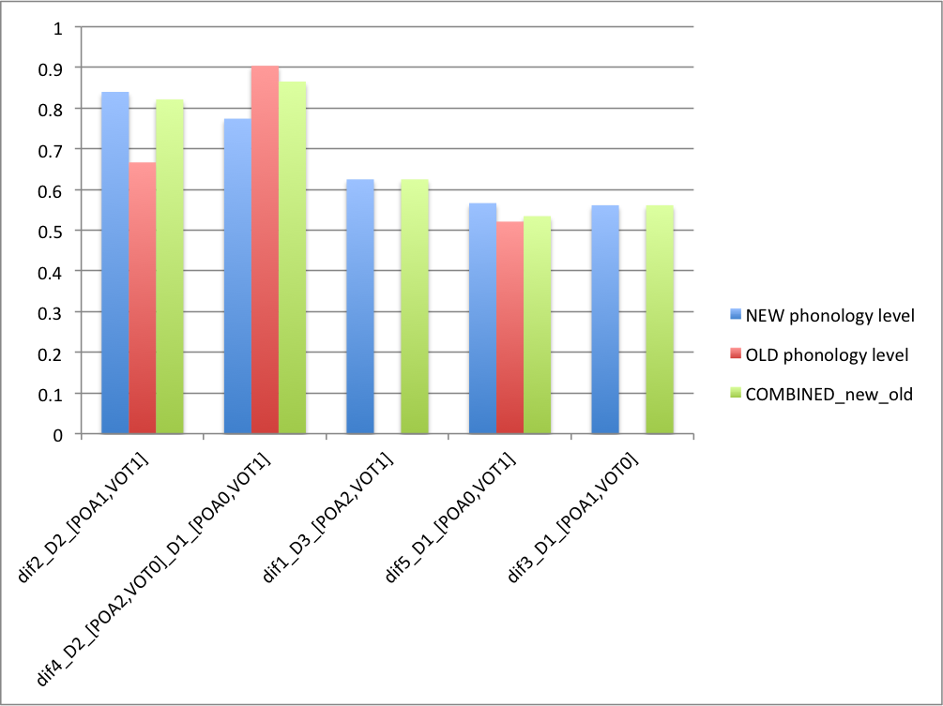
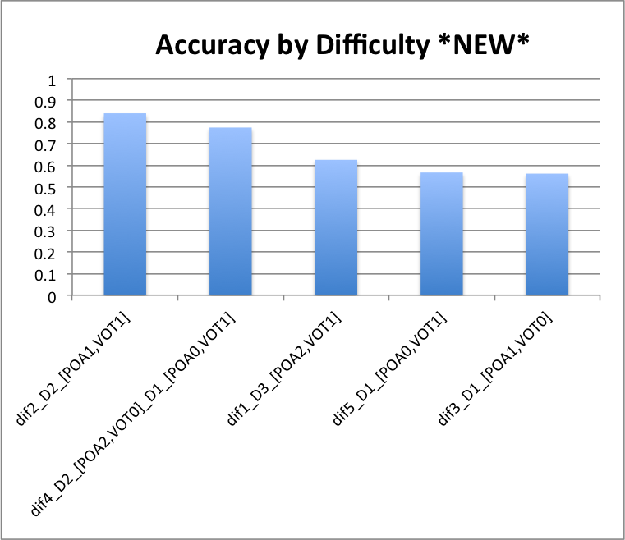
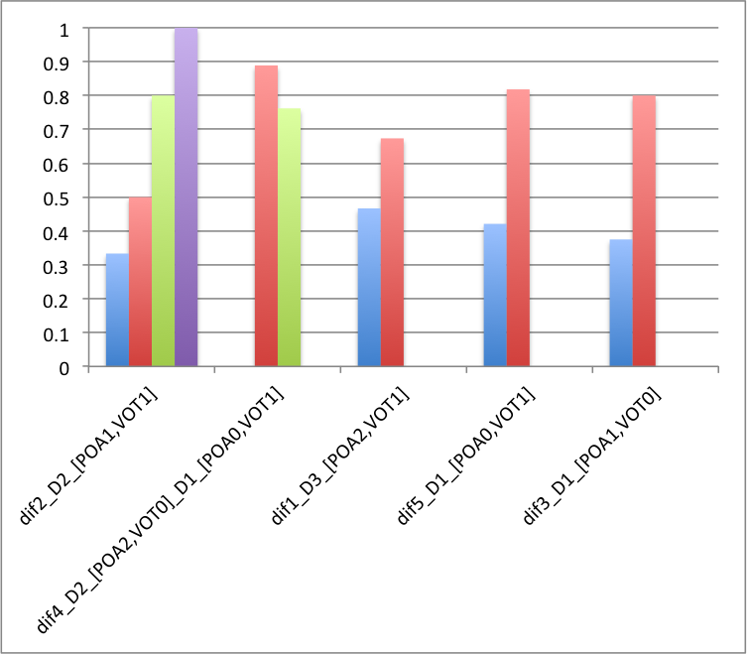
Accuracy by Difficulty

Slide 11
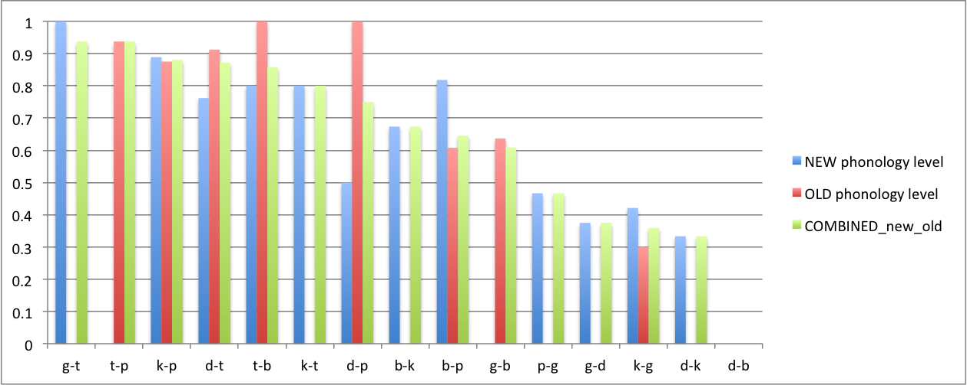
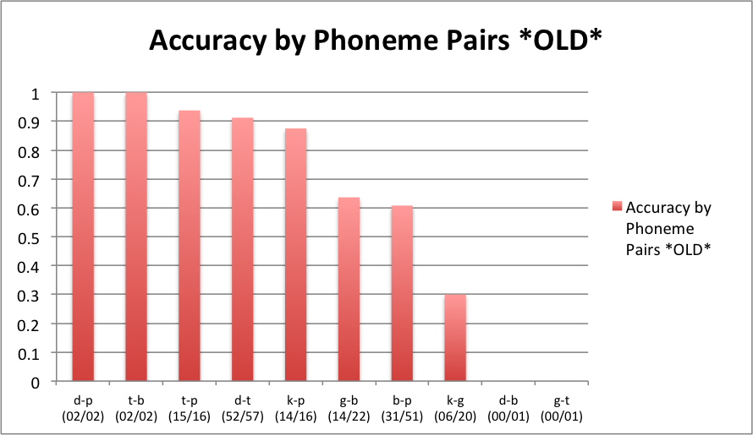
Accuracy by Phoneme
POA
 | Lips | Roof of Mouth | Back of Throat
Early | BA | DA | GA
Late | PA | TA | KA
VOT

Slide 12
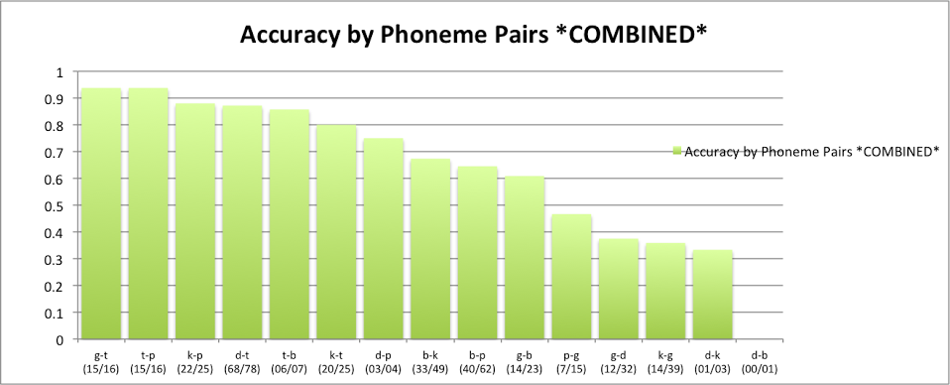
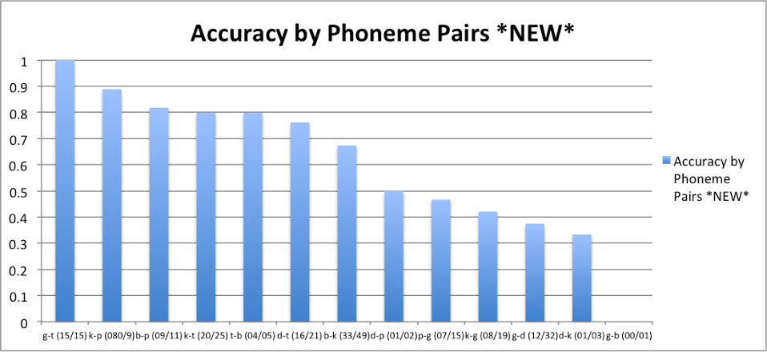
POA
 | Lips | Roof of Mouth | Back of Throat
Early | BA | DA | GA
Late | PA | TA | KA
VOT

Slide 13
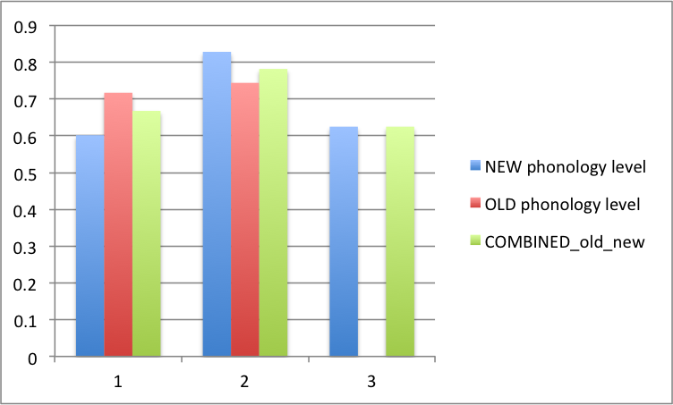
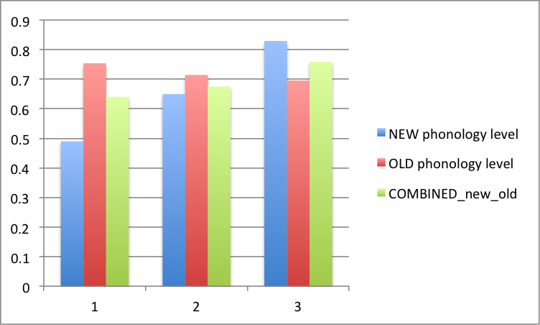
Accuracy by Distance
Accuracy by Position

Slide 14
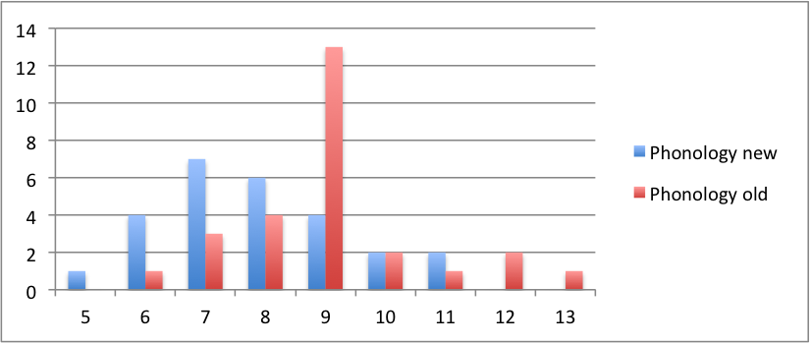
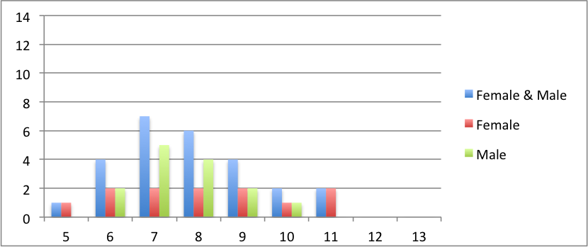
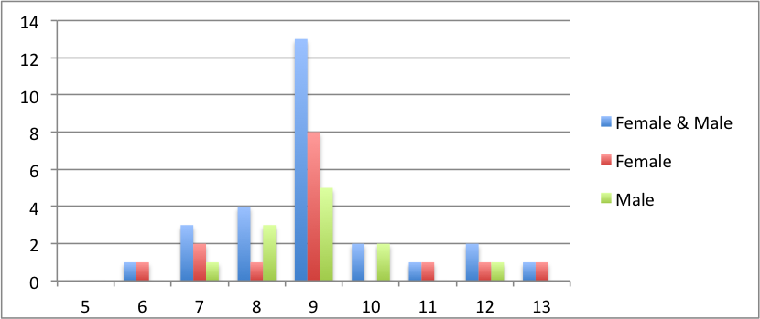
Age Distribution
Age Distribution *NEW*
Total
Age Distribution *OLD*
Total

